Slide 1

Modeling Basics
Modeling Basics
The start-to-finish of Bayesian Cognitive Modeling
Saee Paliwal
TNU CPC
August, 2016

Slide 2
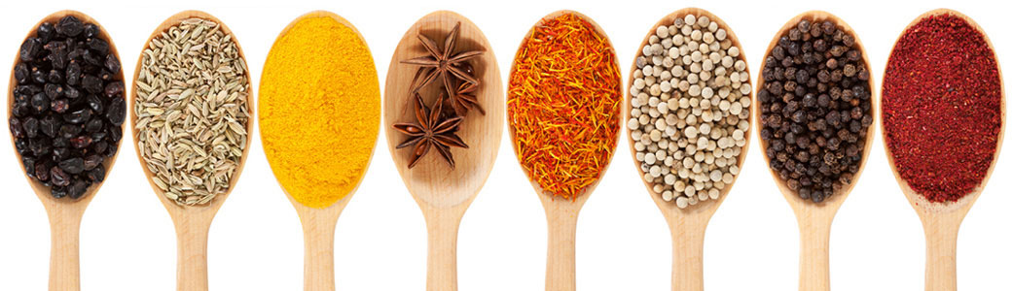
The Starters
who
All cognitive agents model (insects, animals, humans).
what
Learning from data to understand and make predictions about one’s surroundings.
where
Everywhere, in all situations.
when
All day, every day.
why
The ability to understand and predict our environments ensures our survival.
how
Frequentists vs Bayesian

Slide 3
The Frequentist Approach
Based on the data observed, calculate the likelihood of the occurrence of a given event. No additional information.

Slide 4
The prior
What information do we have before we see any data?

Slide 5
The Bayesian approach
Bayes’ Theorem: Posterior Likelihood * Prior

Slide 6

Hamish’s Scottish Taverne Menu
Frequentist approach
Haggis
Haggis deluxe
Haggis supreme
Haggis a la mode
Haggis au gratin
Chicken Tikka Masala
Haggis flambée
Haggis surprise
Make-your-own Haggis
Something else involving Haggis
Looks at the likelihood of an event given the data alone (i.e. how frequently does an event occur)
Likelihood odds ratio, non-Haggis to Haggis:
1:9

Slide 7
Applying Bayes Theorem
But! You have more information.
Prior odds ratio 4: 1
Likelihood ratio 1: 9
Posterior odds ratio 4: 9
So there’s about a 40% chance that you’re not eating sheep stomach. Success.

Slide 8
Our goal
Inferring generative models from observed data.
Notes:
We’re constantly seeing data. This is the Bayesian brain Hypothesis. We want to model the world around us. Our brain is doing the same thing.

Slide 9
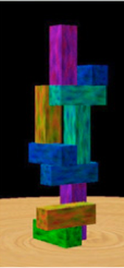
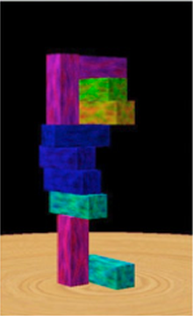
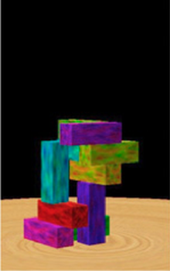
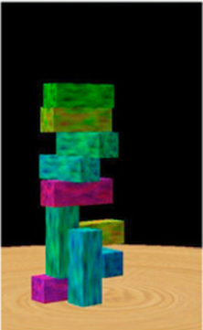
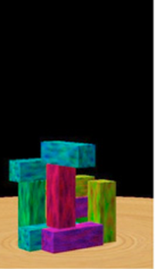
Bayes Theorem - prior

Slide 10
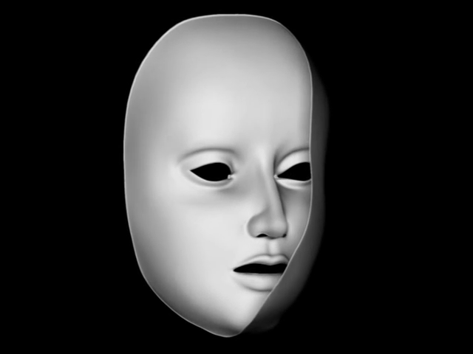
Bayes Theorem - prior

Slide 11
Bayes Theorem
3 elements:
A Model
Parameters
Data

Slide 12
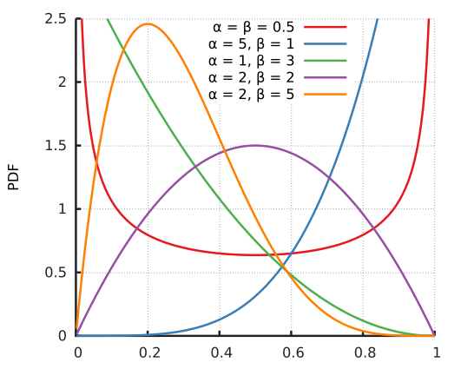
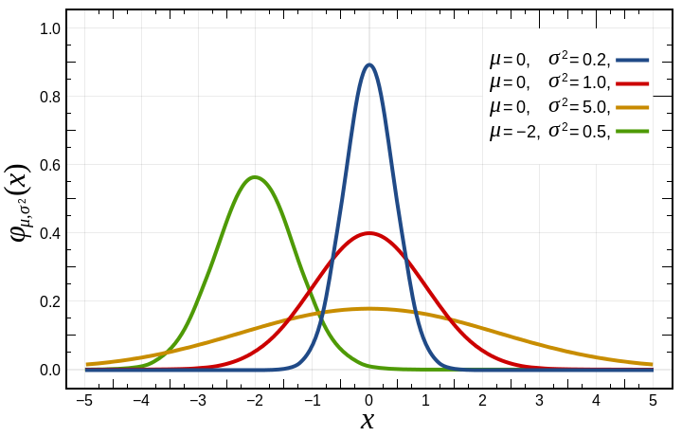
Bayes Theorem: model M
What distribution family do you choose for your prior and likelihood?
Gaussian? Beta?

Slide 13
Bayes Theorem: parameters θ
Parameters θ – this can be mean and variance, or density parameters, etc.

Slide 14
Bayes Theorem: data y
This is whatever information you get from your environment.

Slide 15
Bayes Theorem
Model M + Parameters θ + Data y
Prior:
Likelihood:
Posterior:
Model Evidence:
Bayes’ Theorem: Posterior = Likelihood * Prior
Model Evidence
Model evidence is difficult
to compute, so we work with:

Slide 16

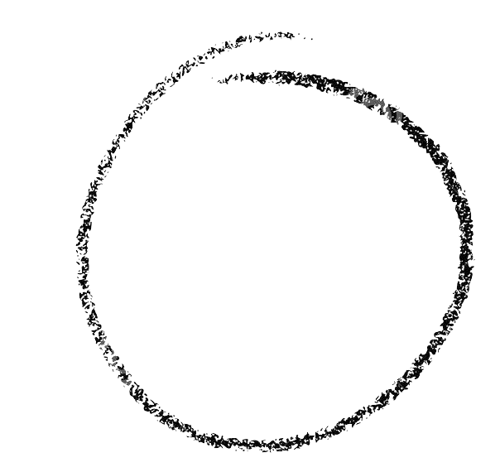

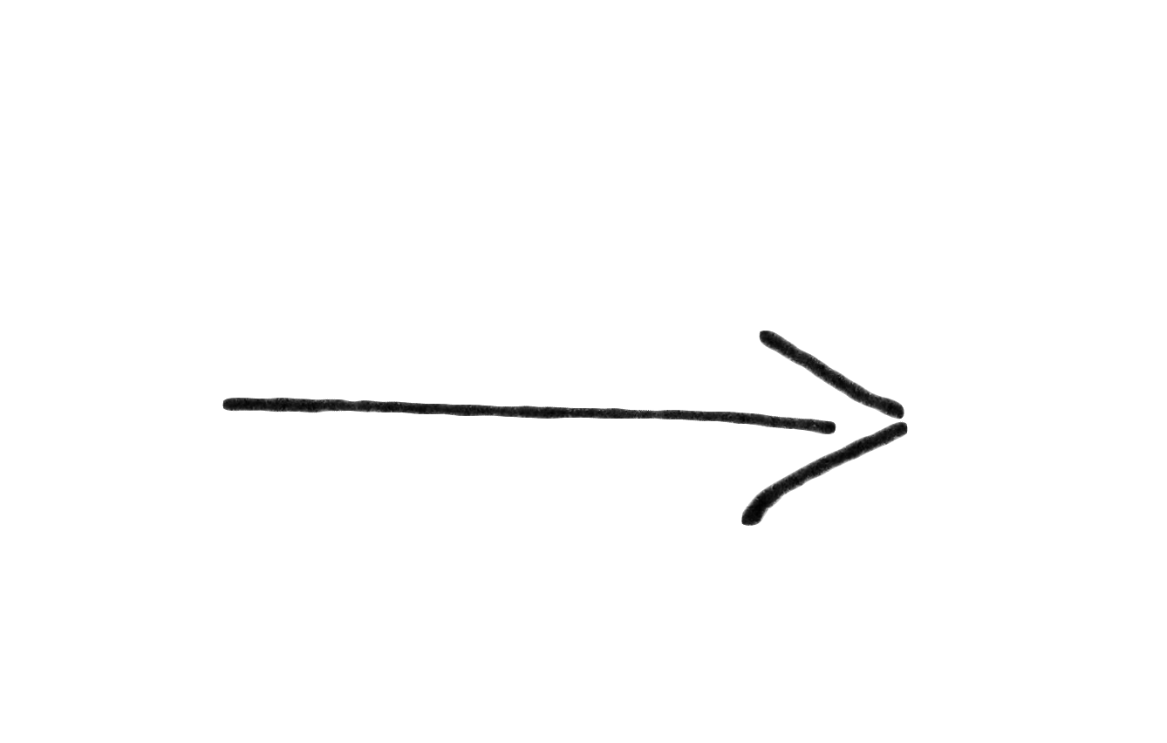
Prep Time:
Longer than you think
Cook Time:
1 PhD duration, or until funding runs out
Plating/serving:
Serve with journal of your choice
Recipe:
Bayesian Cognitive Model
Ingredients:
1. 1 Question or Interest Area
2. 1 well-formed Hypothesis
3. 1 ripe Model
4. 1 heaping Tbsp Simulations
5. 1 medium-sized Task
6. 2 cups Data
7. 9”x12” Inversion Technique
8. Model selection routine

Slide 17

Our problem: The Tricky Coin

Slide 18
Prep Time:
Longer than you think
Cook Time:
1 PhD duration, or until funding runs out
Plating/serving:
Serve with journal of your choice
Recipe:
Bayesian Cognitive Model
Ingredients:
1. 1 Question or Interest Area
2. 1 well-formed Hypothesis
3. 1 ripe Model
4. 1 heaping Tbsp Simulations
5. 1 medium-sized Task
6. 2 cups Data
7. 9”x12” Inversion Technique
8. Model selection routine

Slide 19

Step 1: Question
What is the probability of heads?

Slide 20
Step 2: Hypothesis
3 competing hypotheses encoded in priors
We have no information about the coin = Uniform prior
We believe the coin to be fair = prior around 0.5
We have a suspicion that the coin is unfair = prior around 0.2
Model class: Beta distribution
Prior 1 Prior 2 Prior 3

Slide 21
Prep Time:
Longer than you think
Cook Time:
1 PhD duration, or until funding runs out
Plating/serving:
Serve with journal of your choice
Recipe:
Bayesian Cognitive Model
Ingredients:
1. 1 Question or Interest Area
2. 1 well-formed Hypothesis
3. 1 ripe Model
4. 1 heaping Tbsp Simulations
5. 1 medium-sized Task
6. 2 cups Data
7. 9”x12” Inversion Technique
8. Model selection routine

Slide 22
Step 3: Model
Beta-binomial model.
Prior: Beta distribution
Likelihood: Binomial distribution
For 65 successes, our likelihood looks as follows:

Slide 23
Step 4: Simulations
Simulate 65 successes
Simulations
Hypothesis 1:
Simulations
Hypothesis 2:
Simulations
Hypothesis 3:
Notes:
Why and how do we do simulations. Create a LARGE set of data, why do you do this, can you recover the parameters, are they correlated. How small a set of data can you get to still get a reasonable result. Can you separate the model families. Fminsearch, gradient descent, then sampling and VB

Slide 24
Prep Time:
Longer than you think
Cook Time:
1 PhD duration, or until funding runs out
Plating/serving:
Serve with journal of your choice
Recipe:
Bayesian Cognitive Model
Ingredients:
1. 1 Question or Interest Area
2. 1 well-formed Hypothesis
3. 1 ripe Model
4. 1 heaping Tbsp Simulations
5. 1 medium-sized Task
6. 2 cups Data
7. 9”x12” Inversion Technique
8. Model selection routine

Slide 25
Step 5: Task - Coin toss
Our task is to observe 100 coin flips and estimate the probability of heads.
Say we observe 65 successes (heads).

Slide 26
Step 6: Data
Say we now play the task. We observe a set number of heads, say 45 heads out of 100 tosses.

Slide 27
Prep Time:
Longer than you think
Cook Time:
1 PhD duration, or until funding runs out
Plating/serving:
Serve with journal of your choice
Recipe:
Bayesian Cognitive Model
Ingredients:
1. 1 Question or Interest Area
2. 1 well-formed Hypothesis
3. 1 ripe Model
4. 1 heaping Tbsp Simulations
5. 1 medium-sized Task
6. 2 cups Data
7. 9”x12” Inversion Technique
8. Model selection routine

Slide 28
Step 6: Model Inversion
We now want to assess which of our competing hypotheses (i.e. our 3 priors) is most plausible. In order to do so, we invert our Beta-Binomial model on the observed data. This involves approximating the posterior distribution.
Markov Chain Monte Carlo (MCMC):
Mechanism: sample from a proposal distribution and generate a set of plausible samples from the posterior
Advantages: more precise
Drawbacks: computationally intensive (often takes a long time)
Variational Bayes:
Mechanism: Analytic inversion of a model under the mean field approximation
Advantages: extremely fast
Drawbacks: often inexact
More info:
Tuesday afternoon

Slide 29
Inversion continued
Variational Bayes uses free energy as its variational principle to calculate an approximate posterior. Free energy is the lower bound on model evidence.
Expected Log-joint
(Accuracy)
Entropy
(Complexity)
Convergence

Slide 30
Inversion results
Inversion results:
Posterior 1 Posterior 2 Posterior 3
Notes:
The question now is: how do we select the best model?

Slide 31
Step 8: Model selection
Free energy comparison allows us to select the best model.
Expected Log-joint
(Accuracy)
Entropy
(Complexity)
Model comparison results
Prior 1 Prior 2 Prior 3
Free Energy
More info:
Tuesday Morning
1 2 3

Slide 32
Winning model
Prior ~ Be(2,5)
Likelihood ~ Bin(45,100)

Slide 33
Prep Time:
Longer than you think
Cook Time:
1 PhD duration, or until funding runs out
Plating/serving:
Serve with journal of your choice
Recipe:
Bayesian Cognitive Model
Ingredients:
1. 1 Question or Interest Area
2. 1 well-formed Hypothesis
3. 1 ripe Model
4. 1 heaping Tbsp Simulations
5. 1 medium-sized Task
6. 2 cups Data
7. 9”x12” Inversion Technique
8. Model selection routine

Slide 34
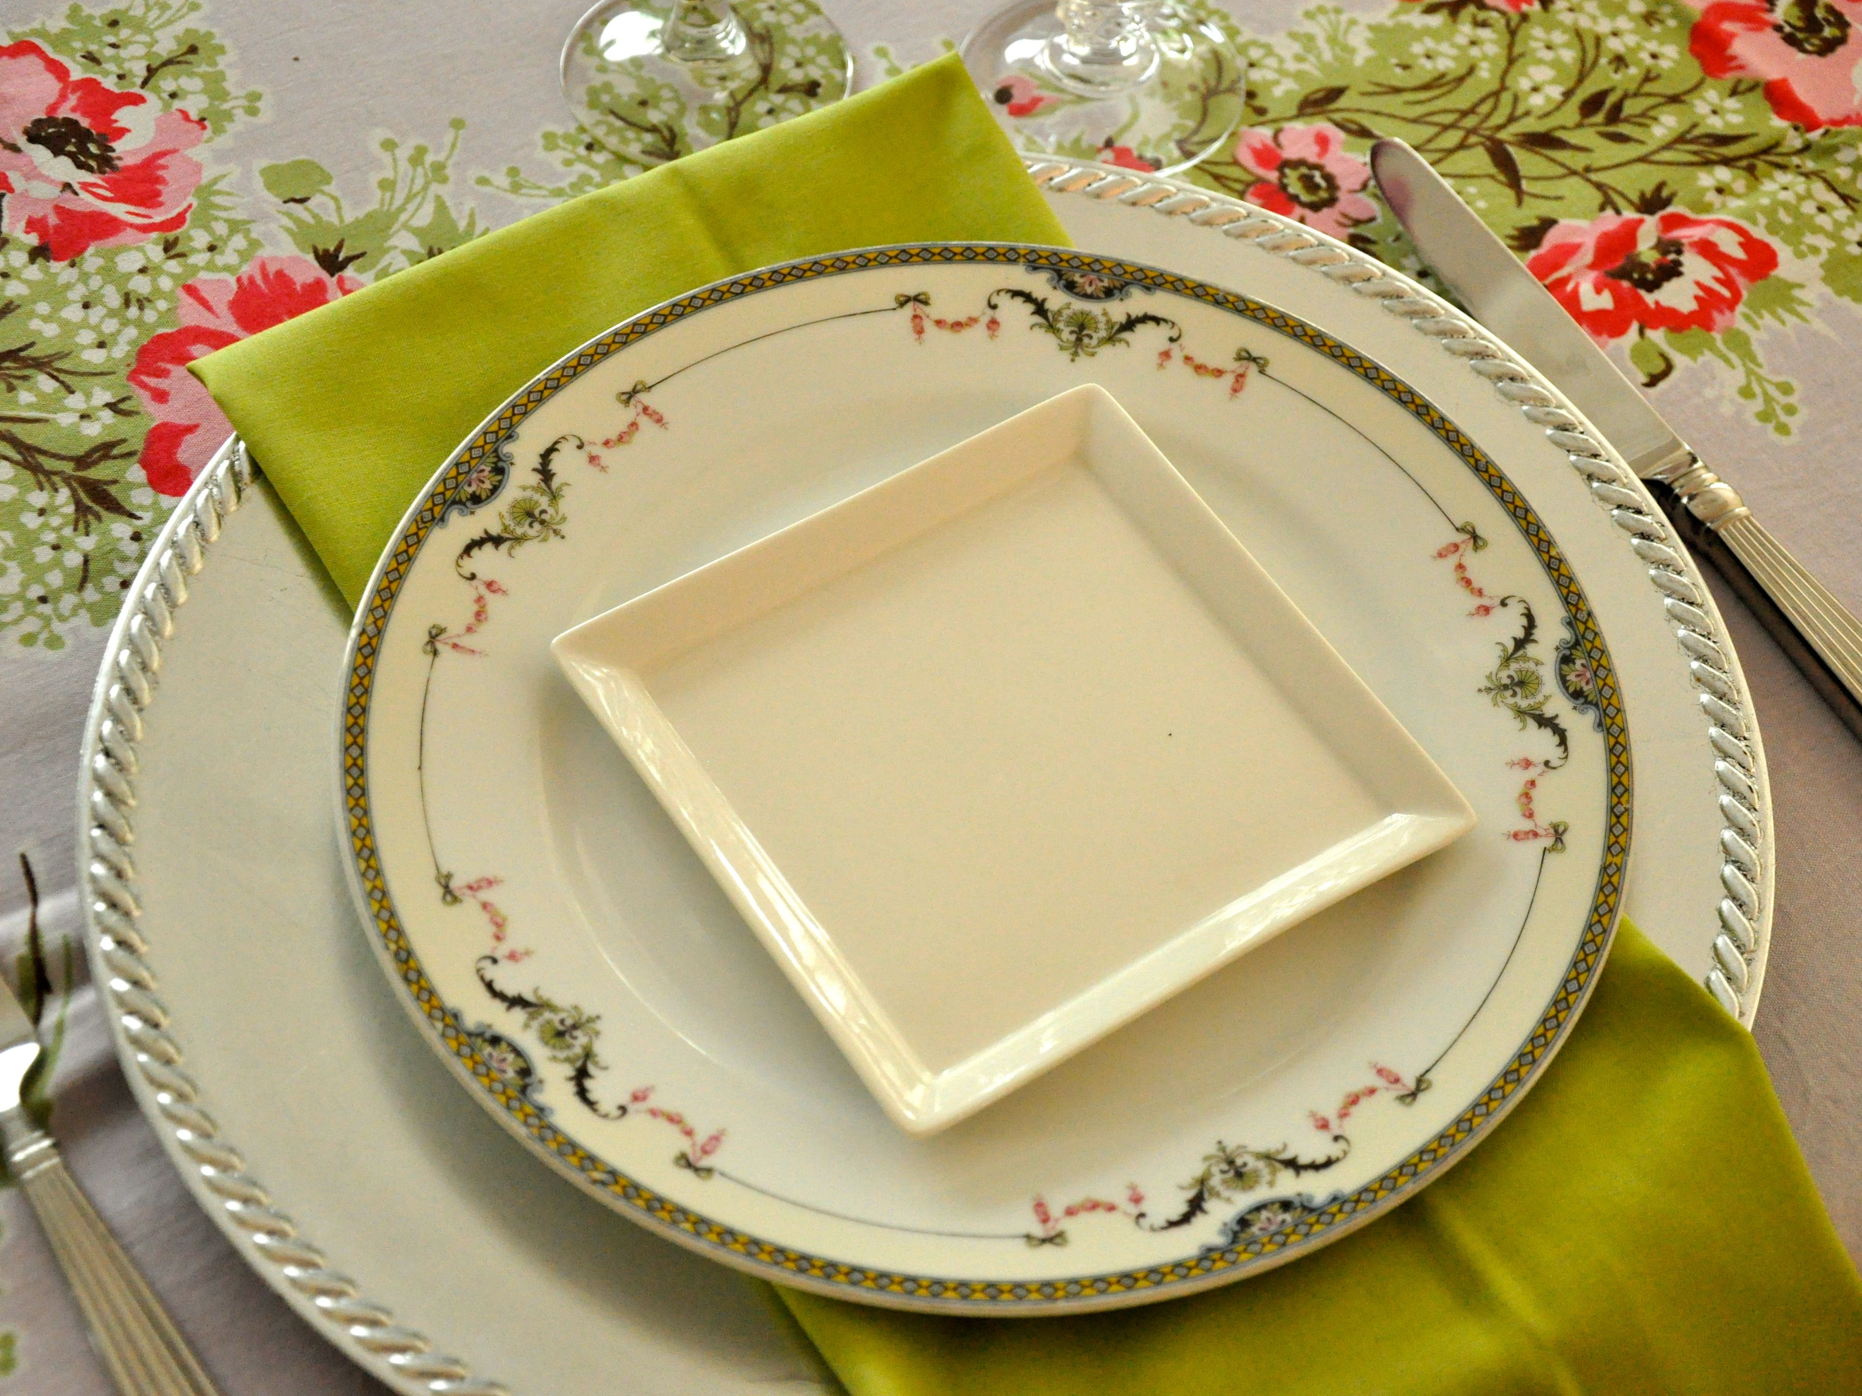
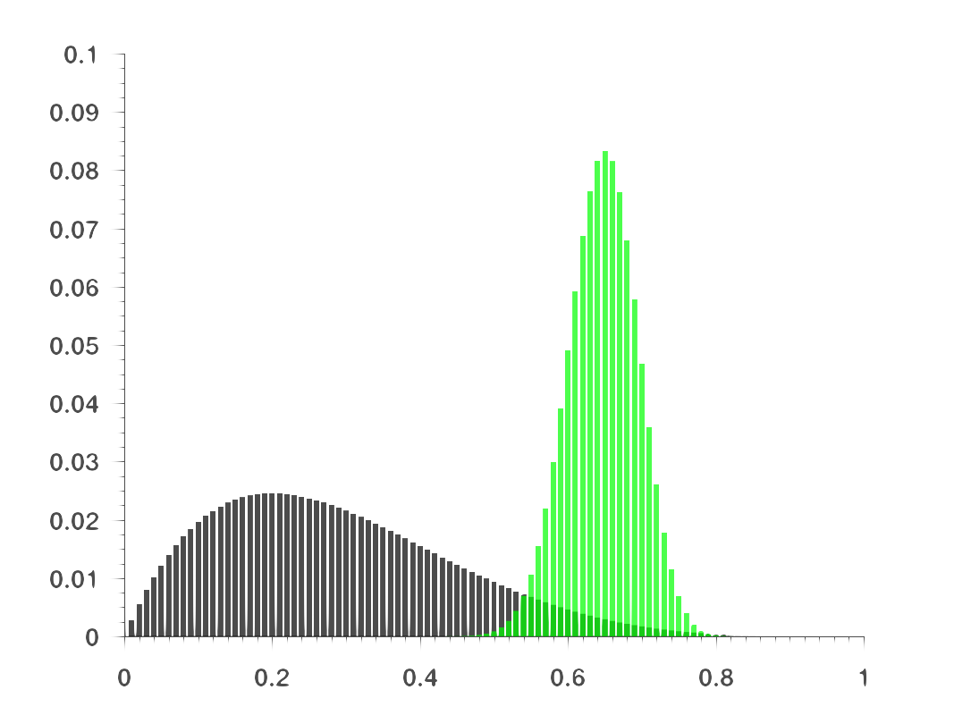
Plate and serve!

Slide 35
Thank you!

Slide 36
Questions?

Slide 37
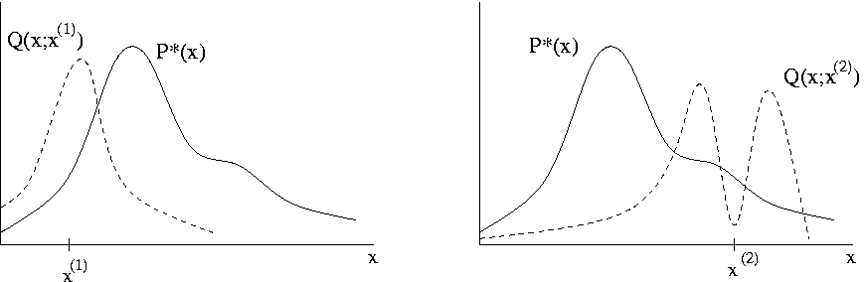
Metropolis-Hastings
Goal:
Generate samples
from the posterior
distribution
Algorithm:
Generate a candidate parameter x* from the proposal distribution q(x)
Calculate the acceptance ratio α = f(x*)/f(x) where f is the approximate posterior
If α ≥ 1, then automatically accept

Slide 38
Harmonic mean
Simple approximation of the model evidence, often likened to the free energy (but not equivalent)
Functional form:

